Slide 1
Tasty BYTES case study
Nikesh Chavhan

Slide 2
ABOUT US
Tasty Bytes is a meal planning and delivery company founded in 2020 during the Covid pandemic. Our mission is to provide inspiration and healthy meal options for our subscribers, regardless of their budget. We offer a variety of subscription plans to suit different needs, including ingredient delivery for our premium plan subscribers.

Slide 3
Project overview
The project involves predicting which recipes will lead to high traffic on Tasty Bytes' website. The data science team was tasked with developing a machine learning model that could predict high traffic recipes with an accuracy of at least 80%. .

Slide 4
BUSINESS GOALs
The business goal is to predict which recipes will lead to high traffic on the website.
The company has noticed that traffic to the rest of the website goes up by as much as 40% if a popular recipe is featured on the homepage.
The goal is to build a model that can correctly predict high-traffic recipes with at least 80% accuracy to ensure that the recipes featured on the homepage drive maximum traffic and ultimately increase subscriptions.

Slide 5
How we addresses the problem
We began by collecting and analyzing a dataset of previous recipe traffic data to identify patterns and trends. Using this data, we trained a machine learning model, specifically a LinearSVC model, to predict which recipes are likely to be popular and result in high website traffic. Our model achieved an accuracy of 81%, which met the business goal of correctly predicting high traffic recipes at least 80% of the time.
This approach addresses the problem of uncertain recipe selection by providing a data-driven method for predicting recipe popularity and selecting the most likely high-traffic recipes for display on the homepage. By using this approach, we can improve website traffic and subscriptions, helping Tasty Bytes meet their business goals.

Slide 6
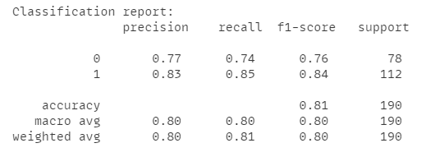
Findings
Based on our analysis of Tasty Bytes' recipe traffic data, we have developed a LinearSVC model with an accuracy of 81%.
This means that our model can predict with 81% certainty which recipes will result in high traffic to the website.
Our confusion matrix shows that out of the 190 recipes analyzed, 58 were correctly classified as low traffic recipes and 95 were correctly classified as high traffic recipes.
Looking at our classification report, we can see that the precision and recall scores for high traffic recipes are relatively high at 0.83 and 0.85, respectively. This indicates that our model is doing a good job of identifying high traffic recipes.
However, our precision and recall scores for low traffic recipes are not as strong, the precision and a recall score of High Traffic recipe.

Slide 7
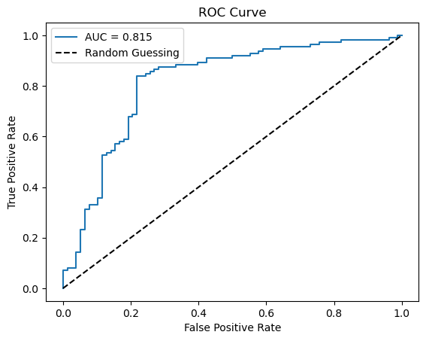
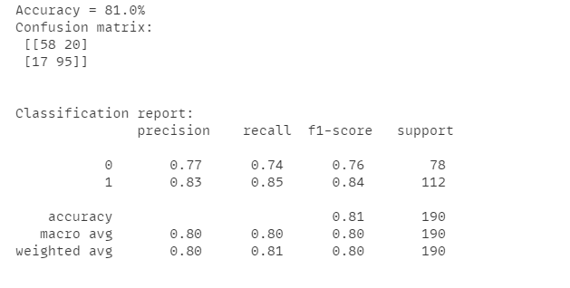
metrics

Slide 8
recommendations
We recommend deploying the machine learning model into production as soon as possible to predict high traffic recipes and help the Product Manager increase website traffic.
Further data collection is recommended, including information such as time to make, cost per serving, ingredients, site duration time, income links, and combinations of recipes.
By collecting more data, the company can gain a better understanding of user behavior and preferences, which can be used to improve website content and user experience.
Regular monitoring of the accuracy metric is recommended to ensure that the model is performing optimally and providing accurate predictions.

Slide 9
SUMMARY
To conclude, we believe that our project has addressed the company's problem of predicting which recipes will lead to high traffic, and our LinearSVC model achieved an accuracy rate of 81%. We recommend deploying the model in production and collecting more data to improve the accuracy even further.
Overall, we are confident that our model will help Tasty Bytes increase website traffic and subscriptions, ultimately leading to increased revenue for the company.

Slide 10
THANK YOU
Nikesh Chavhan​
+91 7448223125
vicky0x07@gmail.com
https://www.linkedin.com/in/nikesh-chavhan/

